Slide 1
A Secure Intrusion detection system against DDOS attack in Wireless Mobile Ad-hoc Network

Slide 2
ABSTRACT
Propose a versatile framework in which one can employ different machine learning algorithms to successfully distinguish between malware ﬁles and clean ﬁles, while aiming to minimise the number of false positives. In this paper we present the ideas behind our framework by working ﬁrstly with cascade one-sided perceptrons and secondly with cascade kernelized one-sided perceptrons. After having been successfully tested on medium-size datasets of malware and clean ﬁles, the ideas behind this framework were submitted to a scaling-up
Process that enable us to work with very large datasets of malware and clean ﬁles.
Finally, the experimental results shows that the performance metrics such as accuracy, precision, recall and confusion matrix

Slide 3
OBJECTIVES
The main objective of our project is,
To detect the Malware type attack effectively.
To implement the machine learning using Random Forest ,Decision ,SVM ,gradient boosting and naive Bayies .
To enhance the overall performance analysis.

Slide 4
EXISTING SYSTEM
In existing system, The malware ﬁles in the training dataset have been taken from the Virus Heaven collection. The test dataset contains malware ﬁles from the WildList collection and clean ﬁles from different operating systems (other ﬁles that the ones usedin the ﬁrst database). The malware collection in the training
and test datasets consists of trojans, backdoors, hacktools, rootkits, worms and other types of malware. The ﬁrst and third columns in Table II represent the percentage of those malware types from the total number of ﬁles of the training and respectively test datasets. The second column in Table II represents the corresponding percentage of malware unique combinations from the total number of unique combinations of feature values for the training dataset

Slide 5
DISADVANTAGES
It doesn’t efficient for large volume of data’s
Training model prediction on Time is High
It is based on Low Accuracy

Slide 6
PROPOSED SYSTEM
The proposed model is introduced to overcome all the disadvantages that arises in the existing system. This system will increase the accuracy of the classification results by classifying the data based on the software quality prediction dataset and others using SVM , Gradient Boosting ,Naive Bayes Random forest and decision Tree algorithms.It enhances the performance of the overall classification results.
the experimental results shows that the performance metrics such as accuracy, precision, recall and confusion matrix.

Slide 7
ADVANTAGES
It is efficient for large number of datasets.
It is more effective of performance analysis.
High performance.
Provide accurate prediction results.
It avoid sparsity problems.

Slide 8
LITERATURE REVIEW
Title: Cloud security architecture based on user authentication and symmetric key cryptographic techniques, 2020
Author: Abdul Raoof
Technologies and Algorithm Used:
The study is implemented on the Structure for cloud security with efficient security in communication system and AES based file encryption system. This security architecture can be easily applied on PaaS, IaaS and SaaS and one time password provides extra security in the authenticating users.
Advantages:
Performance time and accuracy
Disadvantages:
Training model prediction on Time is High
It is based on Low Accuracy

Slide 9
LITERATURE REVIEW
Title: Analysis and Countermeasures for Security and Privacy Issues in Cloud Computing, 2019
Author: Q. P. Rana, Nitin Pandey
Technologies and Algorithm Used:
The cloud computing environment is adopted by a large number of organizations so the rapid transition toward the clouds has fuelled concerns about security perspective. There are numbers of risks and challenges that have emerged due to use of cloud computing. The aim of this paper is to identify security issues in cloud computing which will be helpful to both cloud service providers and users to resolve those issues. As a result, this paper will access cloud security by recognizing security requirements and attempt to present the feasible solution that can reduce these potential threats.
Advantages:
More effective and efficient.
Disadvantages:
Not give accurate prediction result.

Slide 10
SYSTEM ARCHITECTURE
Train set
Pre-processed data
Feature Selection
Dataset
Test set
Prediction
Classification

Slide 11
FLOW CHART
Start
Select Dataset
Clean Dataset
Count Vectorizer
Feature Selection
Classification
Prediction

Slide 12
USE CASE DIAGRAM
Start
Select Dataset
Cleaning Dataset
USER
Count Vectorizer Test
Feature Selection
Classification
Prediction

Slide 13
MODULES
Data selection
Data preprocessing
Cloud me
Classification
Result Generation

Slide 14
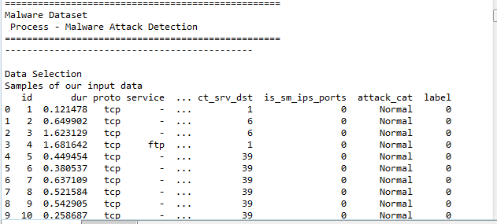
Data selection

Slide 15
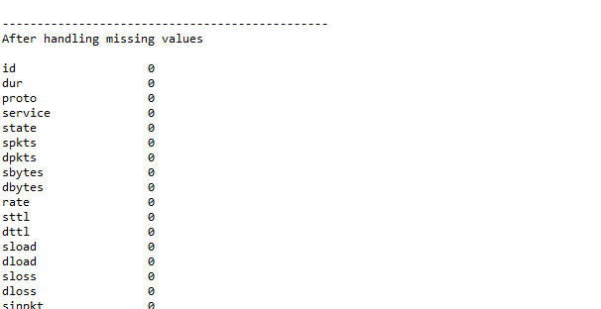
Data preprocessing

Slide 16
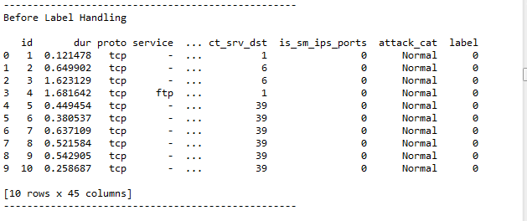
Data Label Encoding

Slide 17
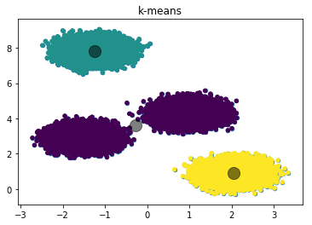
KMEAN CLUSTERING

Slide 18
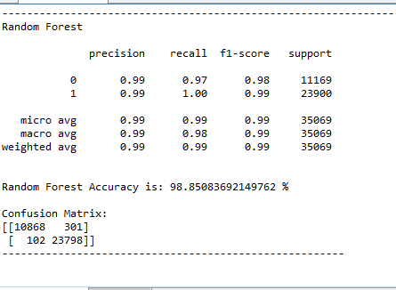
Random Forest

Slide 19
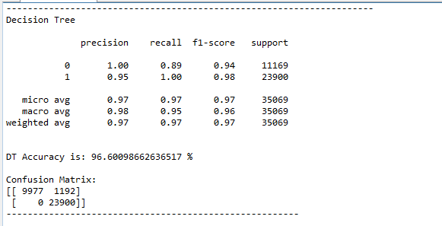
Decision Tree

Slide 20
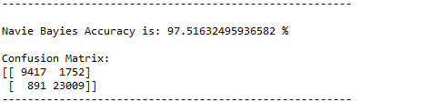
Navie bayies

Slide 21
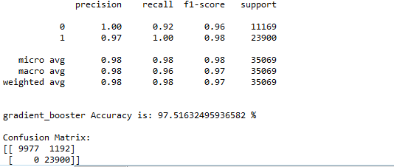
Gradient booster

Slide 22
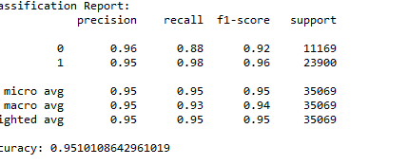
SVM

Slide 23

PREDICTION

Slide 24
Thank You…

